Slide 1

Department of Telecommunication Engineering Jawaharlal Nehru National College of Engineering, Shivamogga
Project seminar on,
“TRAFFIC COUNTING SYSTEM BASED ON OPENCV AND PYTHON”
Presented by,
Pavana B J 4JN14TE025
Rakesh H J 4JN14TE030
Suraj N 4JN14TE042
Vaishakh P J 4JN14TE046
Under the guidance of,
Mr. Benak Patel M.P.
Assistant Professor, Dept of TCE.
JNNCE, Shivamogga

Slide 2
CONTENTS
Introduction
Literature survey
Objective
Block diagram
Working principle
Hardware and Software Components
Flow Chart
Advantages and Applications
Conclusion

Slide 3
INTRODUCTION
Traffic counts, speed and vehicle classification are fundamental data for a variety of transportation projects.
Traffic Monitoring and Information Systems related to vehicles.
A set of traffic parameters such as vehicle classifications, lane changes, parking areas etc., can be measured.
There is a need for vehicle count in particular highway or a street.

Slide 4
LITERATURE SURVEY
H.S. Mohana developed a new approach in detecting and counting vehicles in day environment by using real time traffic using matlab. The technique developed is having simple statistical background. Dynamic selection of images from the sequence is implemented successfully in order to reduce the computation time.
Thanes Wassantachat proposed a system to find the traffic density estimation with On-line SVM Classifier according to the system. Traffic congestion has significant impacts on both the economy and environment. Reducing traffic congestion can improve traffic flow, reduce travel times and the environmental impact.

Slide 5
OBJECTIVE
To develop a system to detect and count moving vehicles automatically using opencv and python.
Raspberry Pi and USB camera are used for detecting and counting vehicles.
This project runs on two different steps:
Step1: to activate camera.
Step 2: detecting vehicles, counting vehicles for recorded video.

Slide 6
BLOCK DIAGRAM
Traffic Data
Video feed
USB Camera
Raspberry Pi module
Power Supply
Raspberry pi 3 Model B
Output
Memory

Slide 7
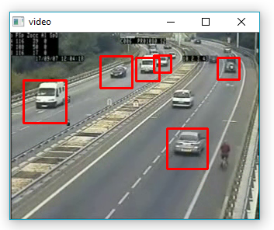
WORKING PRINCIPLE
The project interface of the system which provides several functions as given below:
Activating camera in color mode and grayscale mode.
Detect vehicles from video using opencv functions.
Count vehicles from video stream & display the count.

Slide 8
Hardware components
USB Camera
USB Cameras are imaging cameras that use USB 2.0 or USB 3.0 technology to transfer image data.
Easily interface with dedicated computer systems by using the same USB technology that is found on Raspberry Pi 3.
iBall Face2Face C8.0 web camera with interpolated 8.0MP Still Image resolution, 4.0MP Video resolution and Wide angle lens provides smooth video.

Slide 9
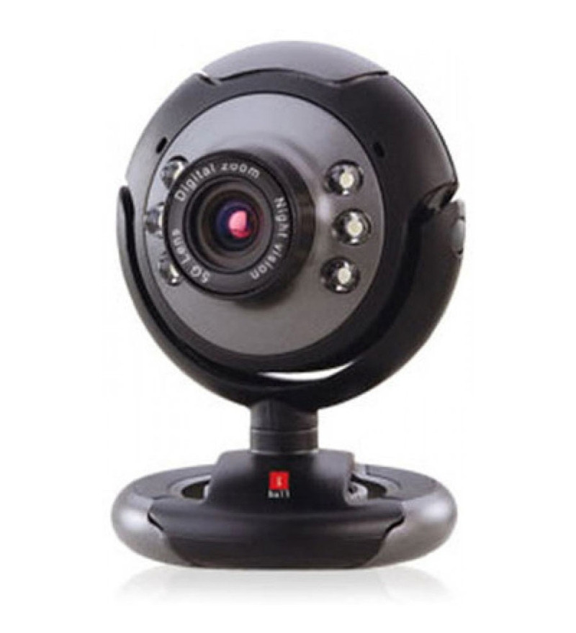
Fig: USB Camera

Slide 10
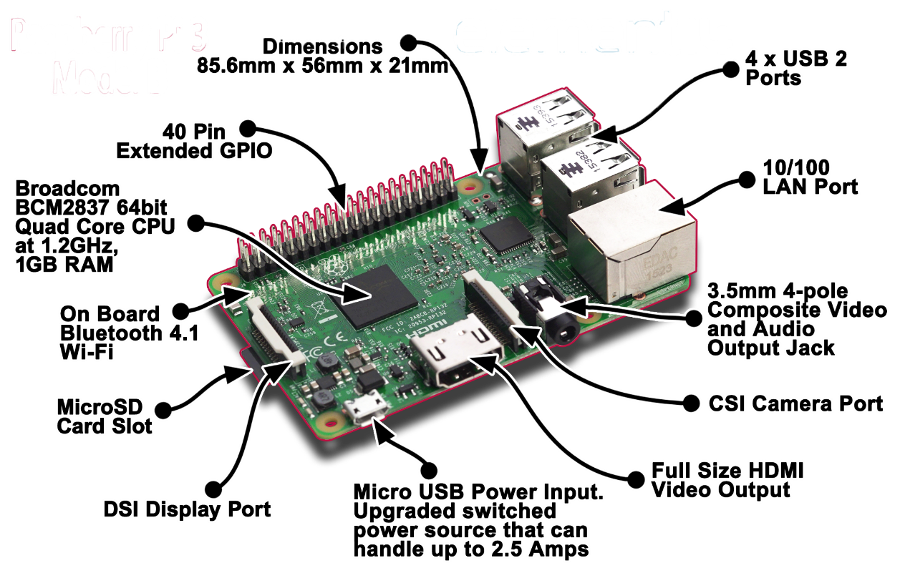
2. Raspberry Pi 3 Model B

Slide 11
Three ways to interact with Raspberry Pi
- directly through HDMI port by connecting HDMI to VGA cable, and keyboard and mouse
- interact from any system through SSH (Secure Shell).
- with VNC server and Viewer.

Slide 12
Technical Specifications of Raspberry pi
Processor
•Broadcom BCM2387 chipset.
•1.2GHz Quad-Core ARM Cortex-A53 (64Bit)
Wireless LAN and Bluetooth 4.1
•IEEE 802.11 Wi-Fi. Maximum range of 100 meters.
•IEEE 802.15 Bluetooth. Maximum range of 50 meters.
GPU
•Dual Core Video Core IV® Multimedia Co-Processor.

Slide 13
Memory
•1GB RAM
Operating System
•Boots from Micro SD card
Dimensions
•85.6 x 56 x 21mm
Power
•Micro USB socket 5.1V, 2.5A
Connectors
Ethernet
•10/100 Ethernet socket
Video Output
•HDMI
Audio Output
•Audio Output 3.5mm jack
USB
4 x USB 2.0 Connector

Slide 14
GPIO Connector
•40-pin 2.54 mm expansion header: 2x20 strip
Camera Connector
•15-pin Camera Serial Interface (CSI)
Display Connector
•Display Serial Interface (DSI) 15-pin port.
Memory Card Slot
•Push/pull Micro SDIO.

Slide 15

3. Micro SD Card
Secure Digital (SD) is a non-volatile memory card format developed by the SD Card Association (SDA) for use in portable devices.
Recommended size is 16GB.
Used to store the Raspbian OS and the video recorded.

Slide 16


SOFTWARE REQUIREMENTS
Raspbian OS
-Recommended OS for Raspberry Pi.
Latest version: 4.14
2. Python
Python is high level language used to work with Raspberry Pi.
Version: 2.7.13

Slide 17


3. OpenCV
Open Source Computer Vision Library
An open source computer vision is machine
learning software library.
Used to detect and recognize objects.
Version: 2.4.13.5
4. VNC server and viewer
VNC server is program installed on
Raspberry Pi for screen sharing and
allows client control (viewer)

Slide 18
Get the input file
Power on system and initiate the camera
Define vehicle parameters
Counting Vehicles after detected vehicle crosses reference line
Calculating vehicle parameters
Detecting vehicles
Smoothing image
Removing background
Filtering image noise
Displaying the output
Fig: Flow Chart

Slide 19
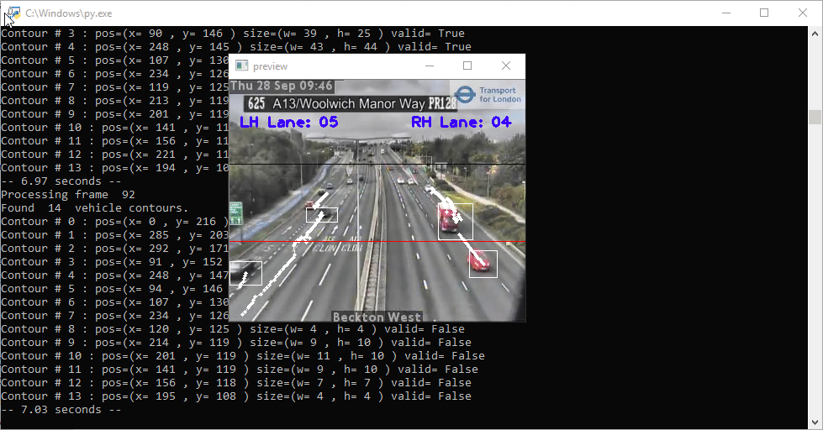

Result window

Slide 20
Advantages
Vehicle classifications, lane changes, parking areas etc., can be measured.
Efficient system and economical.
Labour cost reduction and digital data storage.
System is portable.

Slide 21
Limitations
Recording during night might affect the detecting of vehicle
Constant power supply is needed
Weather conditions may damage the system

Slide 22
Applications
Traffic monitoring and efficient routing.
Find potential accidental hotspots.
Survey purpose for road constructions.
Estimation of possible traffic and peak hours.
Statistical analysis possible.

Slide 23
Conclusion
Traffic counting is made easy with the help of raspberry pi
The data can be monitored remotely using VNC viewer
Data can be used for further applications
This can be used for making the cities smart

Slide 24
REFERENCES
A. J. Kun and Z. Vamossy, "Traffic monitoring with computer vision," Proc. 7th Int. Symp. Applied Machine Intelligence and Informatics (SAMI 2009).
Neeraj K. Kanhere, Stanley T. Birchfield, Wayne A. Sarasua, Tom C. Whitney, Real-time detection and tracking of vehicle base fronts for measuring traffic counts and speeds on highways", Transportation Research Record, No. 1993. (2007).
M. Lei, D. Lefloch, P. Gouton, and K. Madani, "A Video-Based Real-Time Vehicle Counting System Using Adaptive Background Method", 2008 IEEE International Conference on Signal Image Technology and Internet Based Systems, pp. 523-528.
http://hackster.io
http://github.com
http://sourceforge.net

Slide 25
THANK YOU!

